Slide 1


Data Analysis: Project Budget to Actual
By – Pankaj Kumar Yadav

Slide 2
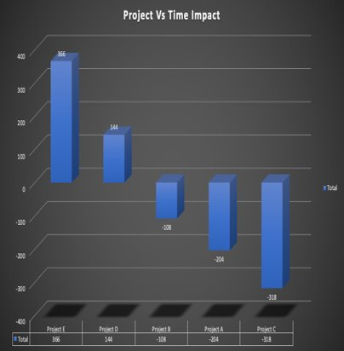
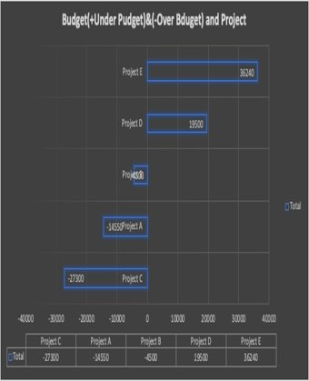
Impact of Time and Cost on Project

Slide 3
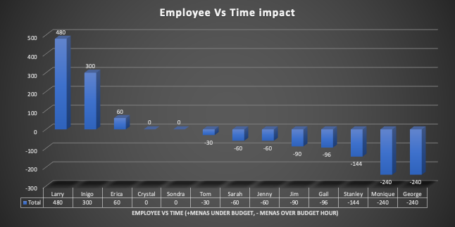
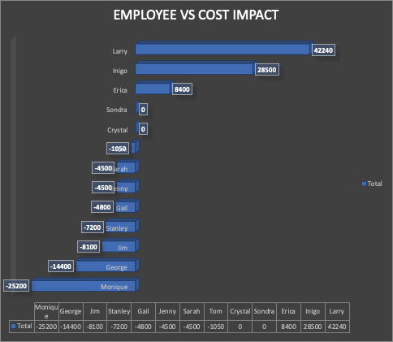
Employee Vs Time Impact and Employee Vs Cost Impact

Slide 4
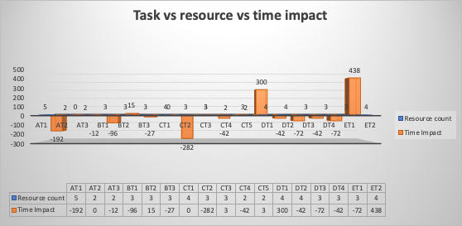
Task, Resource Vs Time Impact
Task, Resource Vs Cost
Sum of Cost of Project | Employees
Task | Crystal | Erica | Gail | George | Inigo | Jenny | Jim | Larry | Monique | Sarah | Sondra | Stanley | Tom | Grand Total
AT1 |  |  | -2100 |  |  | 0 | -10800 |  | 0 |  |  |  | -1050 | -13950
AT2 |  |  | 0 |  |  |  |  |  | 0 |  |  |  |  | 0
AT3 |  |  | 0 |  |  |  |  |  |  |  |  | -600 |  | -600
BT1 |  |  | -1200 |  |  | -4500 |  |  |  |  |  | -600 |  | -6300
BT2 |  | 2100 | 0 |  |  |  |  |  | 0 |  |  |  |  | 2100
BT3 |  | 2100 |  | -1800 |  |  |  |  |  |  |  | -600 |  | -300
CT1 |  |  | 1500 | -1800 |  | 0 |  |  |  |  |  |  | 0 | -300
CT2 |  |  |  | -1800 |  |  |  |  | -25200 |  |  | -600 |  | -27600
CT3 |  | 2100 | 0 |  |  |  |  |  |  |  |  | -600 |  | 1500
CT4 |  |  |  | -1800 |  |  |  |  |  |  |  | -600 |  | -2400
CT5 |  | 2100 |  |  |  |  |  |  |  |  |  | -600 |  | 1500
DT1 | 0 |  |  | -1800 | 28500 |  | 2700 |  |  |  |  |  |  | 29400
DT2 | 0 |  |  | -1800 |  |  |  |  |  | 0 |  | -600 |  | -2400
DT3 | 0 |  |  |  |  |  |  |  |  | -4500 |  | -600 |  | -5100
DT4 | 0 |  |  | -1800 |  |  |  |  |  |  |  | -600 |  | -2400
ET1 | 0 |  | -3000 |  |  |  |  |  |  |  |  | -600 |  | -3600
ET2 |  |  |  | -1800 |  |  |  | 42240 |  |  | 0 | -600 |  | 39840
Grand Total | 0 | 8400 | -4800 | -14400 | 28500 | -4500 | -8100 | 42240 | -25200 | -4500 | 0 | -7200 | -1050 | 9390

Slide 5
Employee Performance Overall
Row Labels | Sum of Cost $ / hr | Cost Impact | Time Impact | Count of Task
Monique | 420 | -25200 | -240 | 4
George | 480 | -14400 | -240 | 8
Jim | 180 | -8100 | -90 | 2
Stanley | 600 | -7200 | -144 | 12
Gail | 400 | -4800 | -96 | 8
Jenny | 225 | -4500 | -60 | 3
Sarah | 150 | -4500 | -60 | 2
Tom | 70 | -1050 | -30 | 2
Crystal | 600 | 0 | 0 | 5
Sondra | 45 | 0 | 0 | 1
Erica | 560 | 8400 | 60 | 4
Inigo | 95 | 28500 | 300 | 1
Larry | 88 | 42240 | 480 | 1
Grand Total | 3913 | 9390 | -120 | 53

Slide 6
Observations and Key Insights
Project E& D completed under Budget Time and Cost, Project A,B,C are over budget in Time and Cost.
Project C is most expansive in term of time and cost, whereas Project E is most time and money saving
Larry, Inigo, Erica, Sondra, Crystal are completed their Project under Budget.
Larry Cost the least whereas Monique cost the most.
Task CT-2 and AT-1 is most expansive in term of time and money.
Monique Stanley George Gail Jim are most expansive employees.
Stanely Task need to minimize he is performing 12 task and taking 600$/h.
Need to divide George, Monique and Gail task also.

